Slide 1
Preparation of Effective PowerPoints
PowerPoint tips for inexperience speakers and those with lots of experience too.

Slide 2
The following information may be of assistance to those who are preparing their first, or 100th, presentation.
You’d be surprised…

Slide 3
Start with a Title Slide
Add a subtitle if you like
Include your name and credentials

Slide 4
Add a Disclosure Slide
ACCME compliance requires all presenters to disclose commercial and financial relationships with commercial or financial interests and/or other relationships with manufacturers of pharmaceuticals, laboratory supplies, and/or medical devices.

Slide 5
Include 2 or 3 Learning Objectives with ACTION VERBS!
At the conclusion of this presentation, participants should be able to:
Analyze
Assess
Choose
Compare
Define
Demonstrate
Describe
Discuss
Distinguish
Evaluate
Explain
Identify
List
Review
Select
Summarize

Slide 6
Do NOT Use
company trade names, logos, or institution logos
You may use
generic or descriptive names of drugs or products if they are relevant to your discussion

Slide 7
There are a few hard and fast rules about what makes a good presentation.
Most people know when they’ve seen a good one.
Most have switched off shortly after the start of a poor offering.
Your presentation style is an extension of your personality and creativity.
The most important rules are:
1 – Keep it short
2 – Make it legible.

Slide 8
Can they see your slide?
Conference rooms can be up to 110 feet deep!
Avoid small or indistinct typefaces, charts with lots of numerical data, or graphs with very thin lines… they will not be legible from the back of the room!

Slide 9
Use PowerPoint Templates for Your Title and Content
Use the “wizards” to create a table, graph, or insert a picture or video
Don’t create extra text boxes
unless they are necessary

Slide 10
Use AT LEAST 24-point Font for the Body of your Slide
NO!
This is 16 point
This is 20 point
This is 24 point
This is 28 point
This is 32 point
YES!
Choose a sans serif plain font
This is Arial
This is Calibri
This is Times New Roman
This is Brush Script
YES!
NO!

Slide 11
Choose the Right Background
Light backgrounds with contrasting type works best in most lighting
Dark backgrounds are hard on the eyes, especially with
certain colors, such as red or blue
Lighter backgrounds are better even
with colors, such as
red or blue

Slide 12
What to Put on a Slide
Summarize with bullet points
Don’t use full sentences
Watch your spacing between lines
Add a graphic if it adds to the message
Use animation features ONLY if they are necessary and add to the content

Slide 13
About Media…
Edit lengthy files to delete irrelevant content and keep only the point you want to make
Embed the media in the PowerPoint
Bring a backup copy of the audio or video file
Go to the Speaker Ready Room the day before your presentation and TEST your media

Slide 14
Be Careful with Data and Images…
Provide a citation for data, statistics, and quotes
And, make sure each is IN YOUR REFERENCE list
Get permission to use copyrighted images
Just because it appears in a Google search doesn’t mean it can be used without permission!

Slide 15
Have you Checked Your Spelling in Your PowerPoint?

Slide 16
Here are some BAD
Presentation Examples

Slide 17
A Bad Slide
In very small, serif typeface
With poorly contrasting colors
Paragraph text appearing all at same time is a bad idea as it is usually hard to follow/read a lot of detailed information and you lose the audience by not breaking up your content into bullets
Difficult to read from the back of the room
Only one minor point worth emphasizing
Almost impossible to spot the relevant bit
Laser pointer waving vaguely… revealing severe hand tremor from nervous speaker

Slide 18
EVEN WORSE!
This slide has even more text than the previous slide.
No attempt has been made to precise the sentences by removing the definite or indefinite article or excising unnecessary verbs.
The sentences spill over the lines creating ‘orphan’ words (as shown above) taking up more space and decreasing legibility.
Is there anything MORE annoying or distracting than having the bullet points fly in?
This slide has been written in even smaller serif typeface.
This white on black ‘Times’ typeface is almost impossible to read from halfway down the room.
It would be unimaginably tedious if the speaker then proceeded to read the entire slide verbatim !!!
By now, the audience has gone to sleep or is reading the next speaker’s abstract – especially if their first language isn’t English.
A laser pointer is virtually invisible when projecting at a distance on a black background – but nobody’s looking by now anyway…

Slide 19
Still hard to read
Larger text size
Sans Serif font
Brighter background, but too busy
Limit contrasting colors

Slide 21
Here are Some Good Examples
(these use the ASRM template)

Slide 22
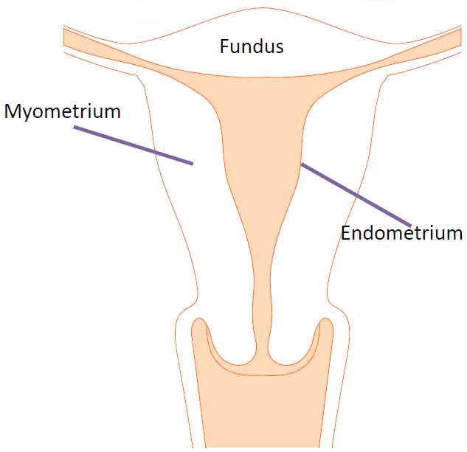
Uterus
Body
Fundus
Peritoneum
Myometrium
Endometrium
Responds to hormones
Site of implantation

Slide 23
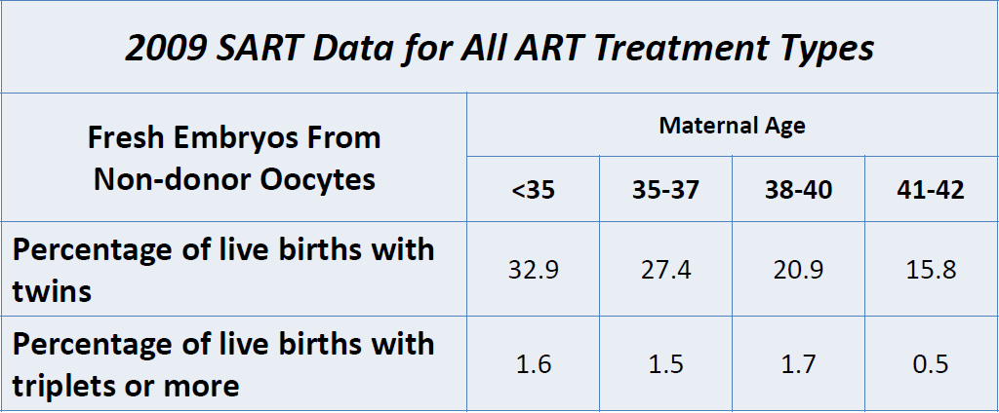
Infertility Treatment and Multiple Gestation Rates
SART, 2009 www.sart.org

Slide 24
Presentation Tips

Slide 25
Know Your Slides
Summarize with bullet points
Don’t use full sentences on slide
Speak full text over slide bullets
Duplicate a slide, instead of scrolling back to refer to a previously viewed slide.

Slide 26
DON’T…
read your slides
Instead, look at your audience, while
you elaborate on the content.

Slide 27
Leave Time for Questions at the End
Questions?

Slide 28
Finally…
Finish with a key point

