Slide 1
How to Upload Files for Presenters
ASRM SPEAKER CENTER AND SPEAKER READY ROOM

Slide 2
Announcement!
ARSM Speaker Ready Room is OPEN and can be accessed by clicking here.
July 17th – October 18th

Slide 3
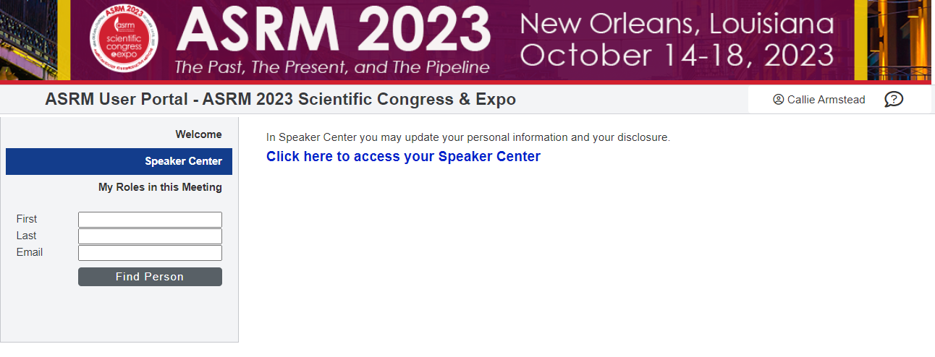
You will need your login credentials to access your Speaker Center.

Slide 4
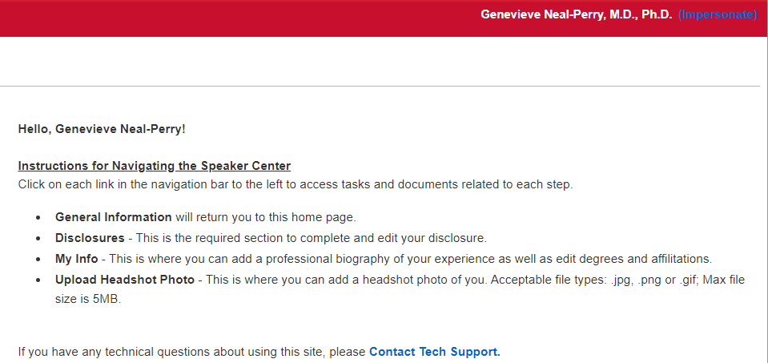
Click on Upload My Files at the bottom on the left-hand side.

Slide 5
Upload your file by clicking on your presentation title.
Click here on the title to upload your presentation

Slide 6
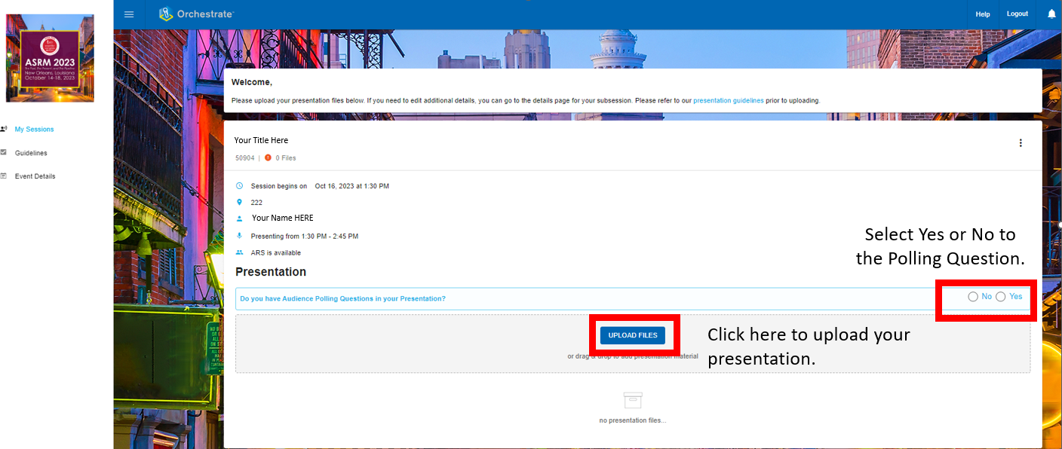
You will now be brought to the ASRM Orchestrate Landing Page. Here, you will be able to upload individual presentation files for each presentation you are presenting.

Slide 7
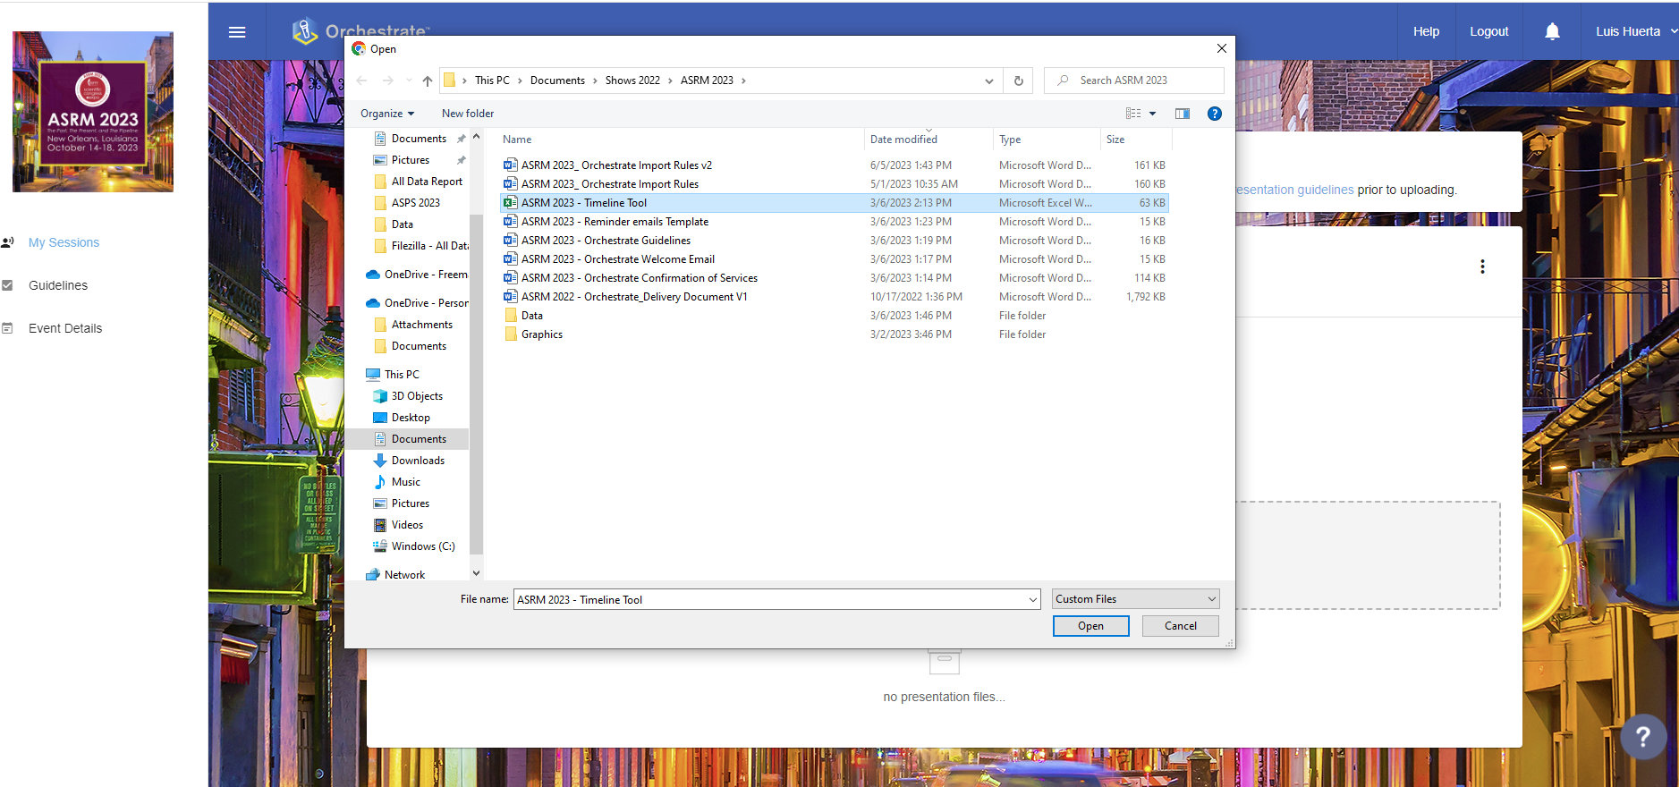
There are two ways to upload: 1)Upload your file by browsing 2)Drag and Drop your presentation.

Slide 8
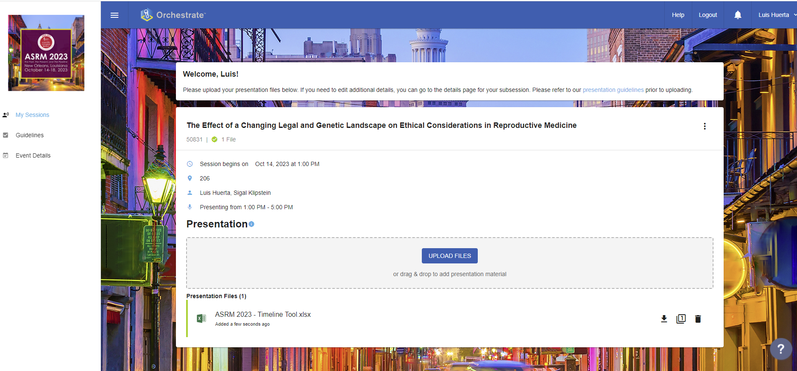
You have now successfully uploaded your presentation!

Slide 9
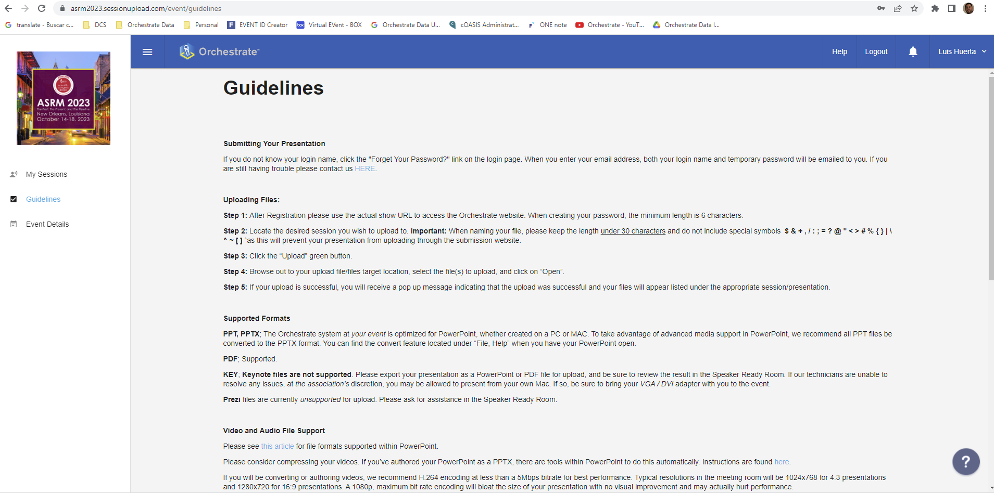
Guidelines are available to assist you.

Slide 10
If you need any assistance while in the Speaker Ready Room, click on the Help button and complete the form.

Slide 11
Thank you! If you need any assistance, please feel free to contact Tech Support for Confex at asrm@confex.com Orchestrate at Orchestrate@freemanco.com or ASRM at abstracts@asrm.org

